Slide 1


Your Guide to Course Registration

Slide 2

Welcome to Huron!
To Get started…
Set up your Western Identity & Email
https://wts.uwo.ca/identity/identities_and_access/identities_new_student.html
Western ONEcard
Log into Student Center>Western Links>Western ONEcard Photo upload by August 2nd to ensure your card can be issued to you on move in day!

Slide 3
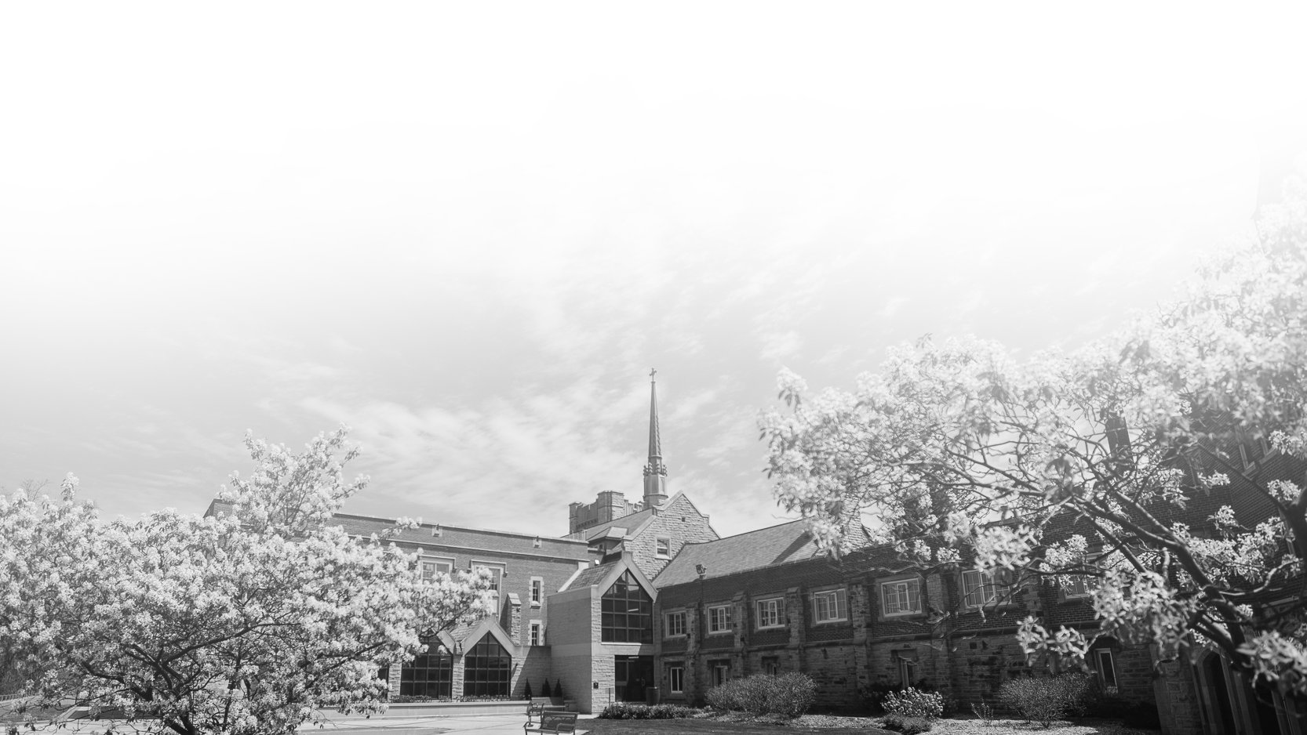
Summer Orientation and Academic Registration
https://huronatwestern.ca/future-students/soar-academic-registration/
Links to prepare you for Course Registration:
Academic Calendar https://www.westerncalendar.uwo.ca/
Western Timetable https://studentservices.uwo.ca/secure/timetables/mastertt/ttindex.cfm
Draft My Schedule Tool https://draftmyschedule.uwo.ca/login.cfm
Academic Advising FAQs https://huronatwestern.ca/student-life/student-services/academic-advising/faq/

Slide 4
First Year Academic Experience
General first-year program
  take program prerequisites courses & electives
Explore subjects that interest you
Keep your academic options open with at least two possible academic plans
Get involved in Huron’s rich extra-curricular and academic community

Slide 5
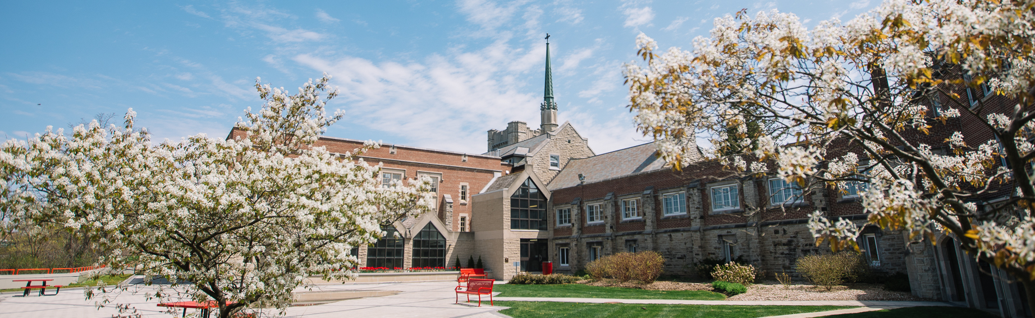
Number of Credits for a Degree
4-year Degree
20.0 credits required
Option 1: Each year take 5.0 courses = 4 years
Option 2: Take reduced course load and/or courses in summer terms = +/- 4 years
3- year Degree
15.0 credits required

Slide 6
Registering for your Courses
Full-time status: 3.5 – 5.0 courses
0.5 courses/credits = one semester course
1.0 courses/credits = full year course
5.0 1000 level courses must be completed
Full academic year = September 8, 2022 to April 30, 2023
Fall term = September 8, 2022 to December 22, 2022
Winter term = January 9, 2023 to April 30, 2023

Slide 7
Residency Requirements
Huron students must take at least 3.0 (or 60%) of their courses at Huron
Up to 2.0 courses that are not offered at Huron may be taken at another campus

Slide 8
Course Suffixes
SUFFIX | WHAT IT MEANS | EXAMPLE
No Suffix | Full year non-essay course | SOCIOLOGY 1020
E | Full year essay course | POLITICAL SCIENCE 1020E
F | First term essay half course | CGS 1023F
G | Second term essay half course | CGS 1023G
A | First term non-essay half course | PHILOSOPHY 1350A
B | Second term non-essay half course | ECONOMICS 1022B

Slide 9
Course Planning & Enrollment
Create your conflict-free timetable at:
https://draftmyschedule.uwo.ca/login.cfm
2. Have your timetable checked by your Academic Advisor
Finalize your enrollment in
Student Center Planning>Enroll in Classes before July 10

Slide 10
Attend a Virtual Academic Registration Session
Date & Time
Tuesday June 14th 2022 1 PM EST / 5 PM GMT
Tuesday June 21st 2022 8:30 AM EST/ 12:30 PM GMT
Tuesday June 28th 2022 10:00 AM EST / 2:00 PM GMT
Tuesday July 5th 2022 8:30 AM EST / 12:30 PM GMT

Slide 11




CONTACT US
If you have any questions or would like to connect with your Academic Advisor,
please reach out to Huron Student Support Services huronsss@uwo.ca
Betty Camarinha
Lauren Hogg
Laura Sedgwick
Katie Benko

Slide 12
Other Important Next Steps
Submit Study Permit Application ASAP
Book your flights to arrive on August 28th at Toronto Pearson Int’l Airport (YYZ) and submit Mandatory Arrival Plan Form as soon as your flight is booked
Attend International Summer Orientation (Virtual) on June 25th or July 4th
Submit final grades/transcript to the Admissions Office when available

Slide 13


huronatwestern.ca | @huronatwestern

